Slide 1

EMPLOYEE DATA ANALYSIS USING EXCEL
STUDENT NAME: SHAKTHI. T S
REG. NO.: 312209508
DEPARTMENT: B.COM BANK MANAGEMENT
COLLEGE: ANNA ADARSH COLLEGE FOR WOMEN

Slide 2

PROJECT TITLE
EMPLOYEE PERFORMANCE ANALYSIS USING EXCEL

Slide 3

AGENDA
Problem Statement
Project Overview
End User
Our Solution and Proposition
Dataset Description
Modelling Approach
Results and Discussion
Conclusion

Slide 4

PROBLEM STATEMENT
Analyzing and evaluating the performance of employees over the past years to identify strengths, areas for improvement, and overall trends that can inform strategic HR decisions.

Slide 5
PROJECT OVERVIEW
It aims to develop a comprehensive framework for evaluating employee performance. The scope includes analyzing job responsibilities, goals, and key performance indicators. A combination of quantitative and qualitative approaches will be used to assess performance. The expected outcome is accurate performance assessments and targeted development plans. This will enable data-driven decision-making to enhance organizational efficiency.

Slide 6
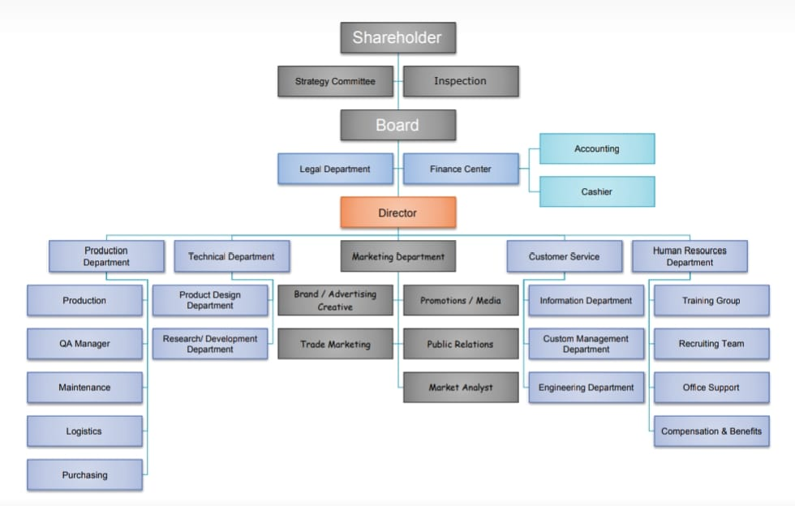
WHO ARE THE END USERS ?

Slide 7
Our solution and its value proposition
• Conditional formatting-missing
• Filter-remove
• Formula-performance
• Pivot-summary
• Graph-data visualization

Slide 8
DATASET DESCRIPTION
• Employee dataset from Kaggle
• 26-features
• We selected 9-features
Employee ID number
Employee name
Employee type
Performance level
Gender
Employee rating number

Slide 9
THE “WOW” IN OUR SOLUTION
Using this formula we have measured the performance level of employees working in an organization
Performance level = IF(Z2>=5,"VERY HIGH",Z2>= 4,"HIGH",Z2>=3,"MED","TRUE","LOW“)

Slide 10
MODELLING
Data collection
-Download the employee dataset from Kaggle
-After the download, an Excel sheet will open
-In that sheet, we have employee data details which have 26 features
Features collection
-We are selecting 9-features for our project
-In that feature, we have employee ID, employee name, employee type, gender, performance level, and employee rating.
Data cleaning
-In this method, we clear the empty rows or columns in the sheet
-By selecting the empty rows and clearing them using a conditional formatting tool

Slide 11
Performance level
-Here, we calculate the performance of the employees
-By using a formula we can calculate the performance
-Using IF formula: =IF(Z2>=5, "VERY HIGH", Z2>=4, "HIGH", Z2>=3, "MED", "TRUE", "LOW“)
Pivot table
-After creating the performance level, click on the pivot table icon
-In that, an application will appear as a row, column, fields
-Select the required items and click ok
-Then using the details create a graph
Summary
-Using this method, we can know the performance level of the employees through the graph

Slide 12
RESULTS Employee Performance Analysis

Slide 13
Performance Level

Slide 14
CONCLUSION
Effective employee performance analysis has far-reaching benefits, including better resource allocation, enhanced accountability, improved succession planning, increased employee retention, data-driven promotions, skills gap identification, enhanced employee experience, strategic alignment, competitive benchmarking, and continuous improvement. Accurate performance assessments enable targeted development initiatives, improved employee engagement, and a culture of constructive feedback, ultimately leading to a high-performing culture that supports the organization's overall mission and objectives.

